Slide 1


Start Smart 1.0
Kindergarten Grade
Lesson 8

Slide 2

ELD Objective
ELD Objective: Students will be able to engage in a Constructive Conversation using the Constructive Conversation Skill of FORTIFY, by taking turns, sharing ideas and making ideas clearer with a partner based on a visual text.

Slide 3
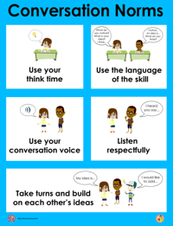
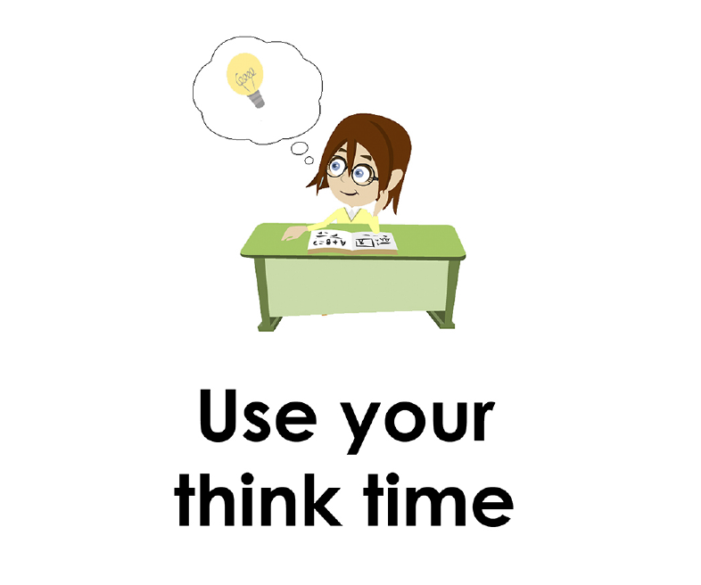
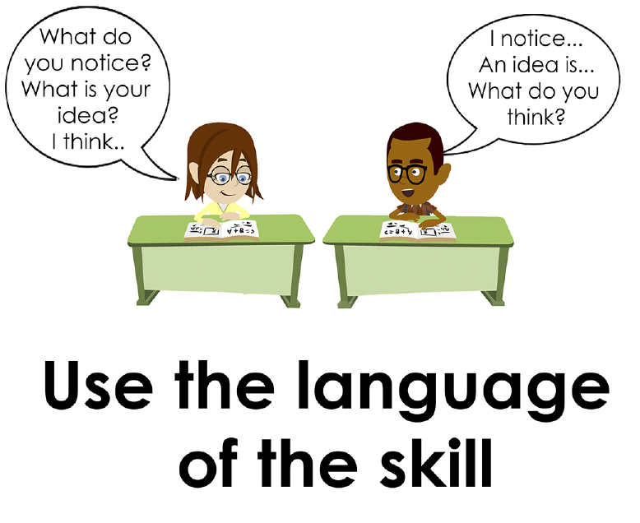
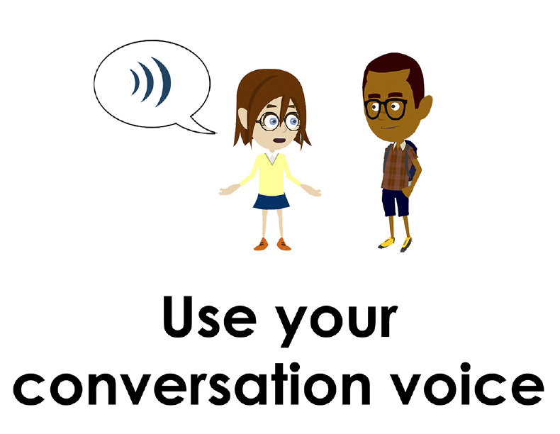
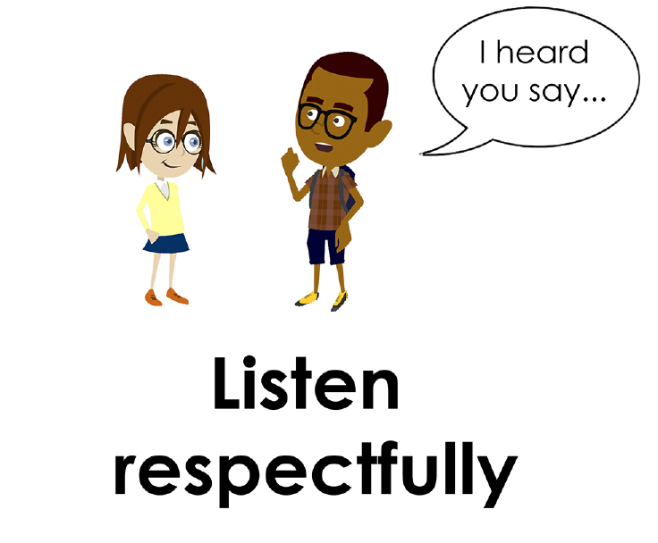
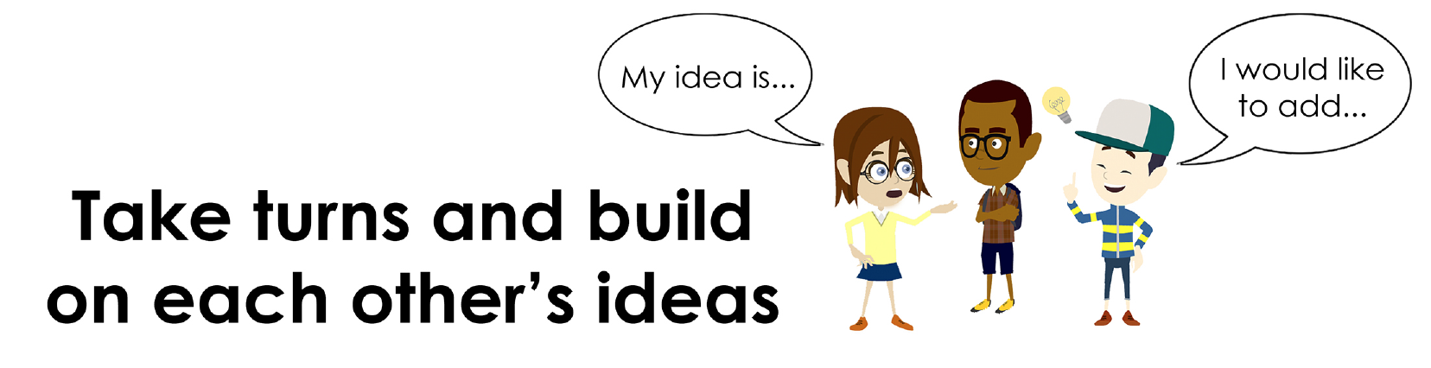
Conversation Norms Poster
  Use your think time
  Use the language of the skill
  Use your conversation voice
  Listen respectfully
  Take turns and build on each other’s ideas

Slide 4
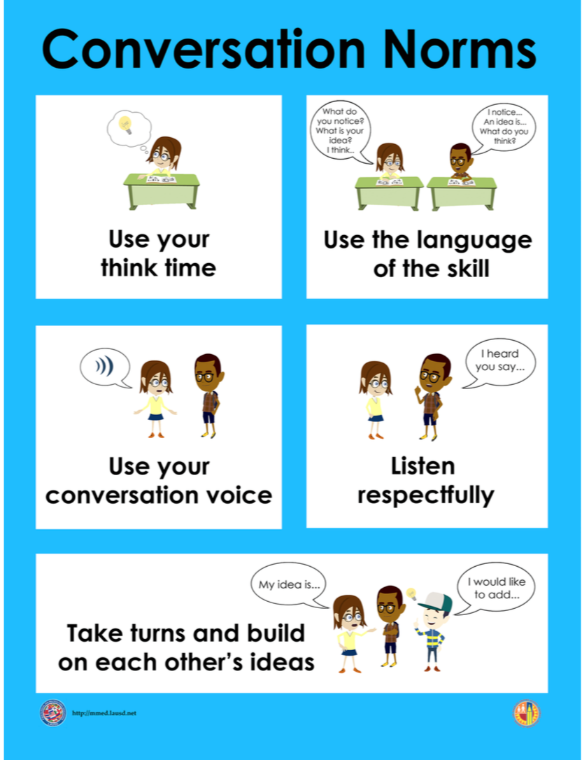
Notes:
The focus today is:
Use your think time
Use the language of the skill

Slide 5
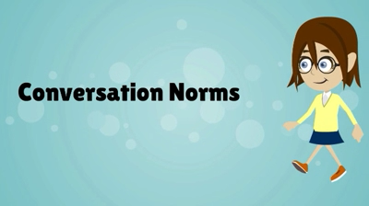
Conversation Norms
Notes:
Show Constructive Conversation Norms Video as a review of all norms

Slide 6
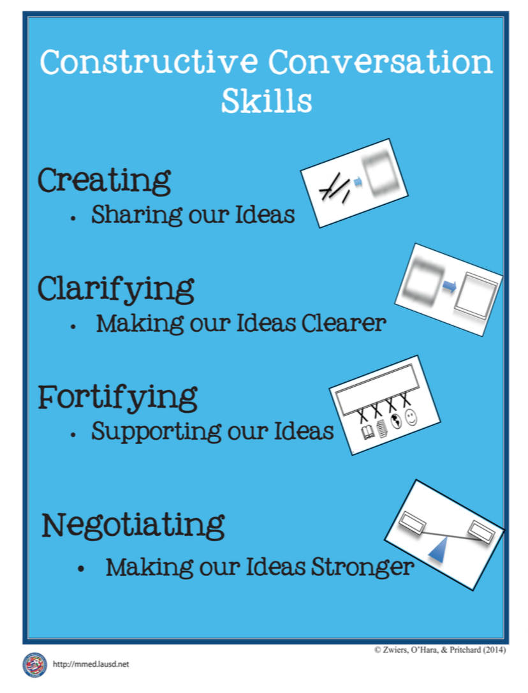
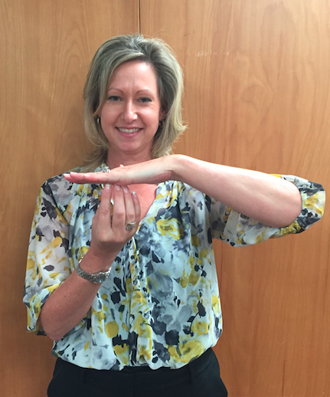
Hand Gesture and Phrase- FORTIFY
Supporting Our Ideas
Notes:
Model FORTIFY and have participants repeat with you:
Place hand, palm down in front of you as if putting an idea on the table. Use four fingertips of the other hand to support the palm.

Slide 8
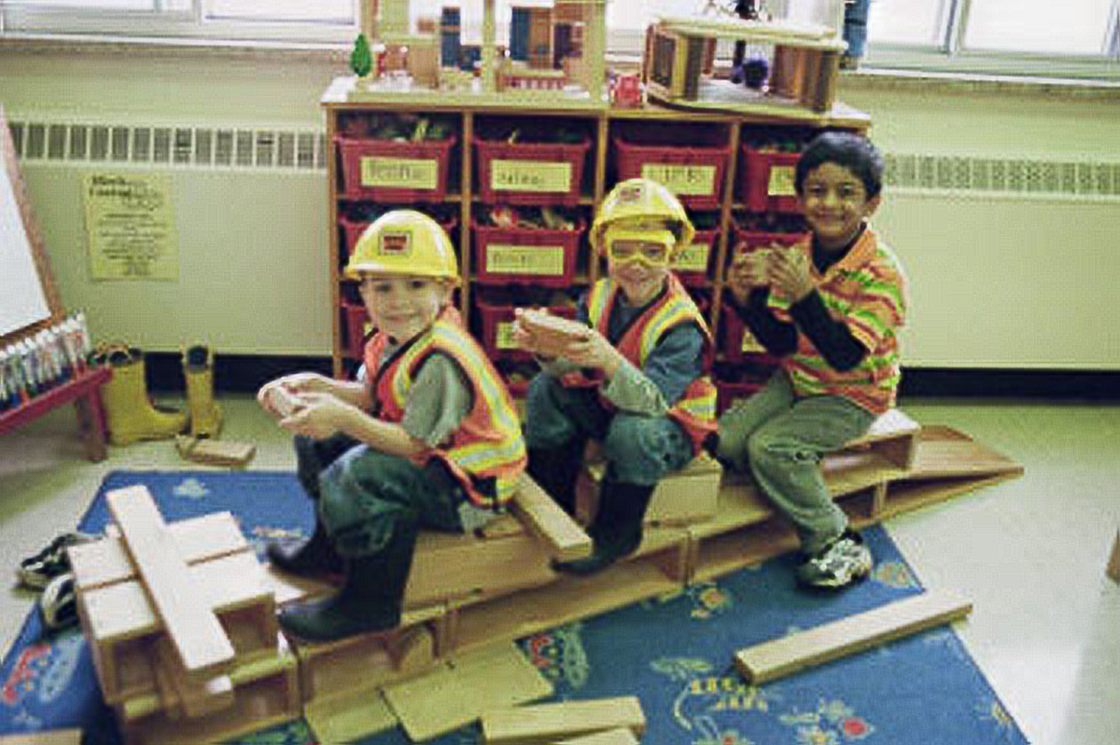
Prompt:
What is happening in this visual text? Provide evidence from the text to support your claim.
TEACHER VISUAL TEXT

Slide 9

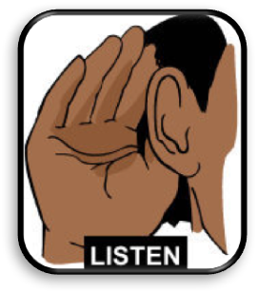
Listen to the Model Constructive Conversation
  Use your think time to study the visual text.
Listen actively to what two partners say to each other.
Notes:
Provide a copy of the Model Script to the volunteer and allow time beforehand for student to review the script. Suggestions for reading the script:
● Show a video of students having the model conversation (optional)
● Student volunteer and teacher read model script
STUDENT LISTEN ACTIVELY

Slide 10
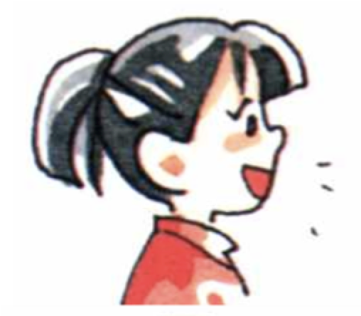
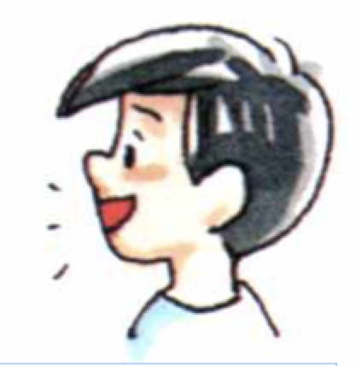
Visual Text Model
What is happening in this visual text. Provide evidence from the text to support your claim.
Partner A: I think what is happening is that the little kids are playing with blocks at school. What do you think is happening is the visual text?
Partner A: I notice that the students used lots of blocks to build something and they are sitting on it. What evidence can you use to support your claim?
Partner A: I notice a rug and bins like at school. I think they are at the blocks center. What can you add to your claim?
Partner A: I think what is happening is that they build a truck at the block center. What do you think?
Partner B: I think what is happening is the kids are pretending they are construction workers. What evidence can you use to support your claim?
Partner B: I notice they are wearing boots, helmets and vests like construction workers. What evidence can you use to support your claim?
Partner B: I notice that all three boys are holding a block and pretending that they are driving. I agree with you that they are at the block center. What do you think?
Partner B: I think what is happening is that they are pretending to be construction workers and they made a truck using blocks at school.

Slide 12
Listen to the Non-Model Constructive Conversation
  Use your think time to study the visual text.
Listen actively to what two partners say to each other.
Notes:
Provide a copy of the Non-­‐‑Model Script to the volunteer and allow time beforehand for student to review the script. Suggestions for reading the script:
● Show a video of students having the model conversation (optional)
● Student volunteer and teacher read model script
STUDENT LISTEN ACTIVELY

Slide 13
Visual Text Non- Model
What is happening in this visual text. Provide evidence from the text to support your claim.
Partner A: I think they are playing. What do you think?
Partner A: I notice they have hats. What do you notice?
Partner A: I notice a rug. I think they are smiling. What do you think?
Partner A: They are playing at the block center. What do you think?
Partner B: I think they are sitting on blocks. What do you notice?
Partner B: I notice they are wearing boots. What do you notice?
Partner B: I notice they are driving. What is happening?
Partner B: They are construction workers.

Slide 14
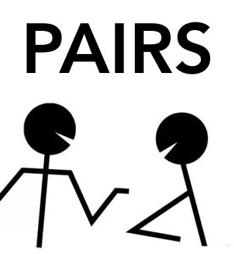
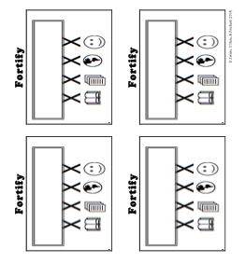
Constructive Conversation Game
PROMPT:
What is happening in this visual text? Provide evidence from the text to support your claim.
Rules of the game:
Each of you needs 1 CREATE, 2 CLARIFY and 3 FORTIFY cards
Each of you will play one card as you share your CREATE, CLARIFY and FORTIFY ideas. You will continue taking turns until all cards are placed in the middle.
If you’re done early repeat the process for an additional round.
Remember to use the Constructive Conversation Norms and Skills as you play the game.
Notes:
You are now going to have the opportunity to practice the Constructive Conversation Skill FORTIFY while playing a game.
Explain the rules of the Constructive Conversation Game to students.

Slide 15
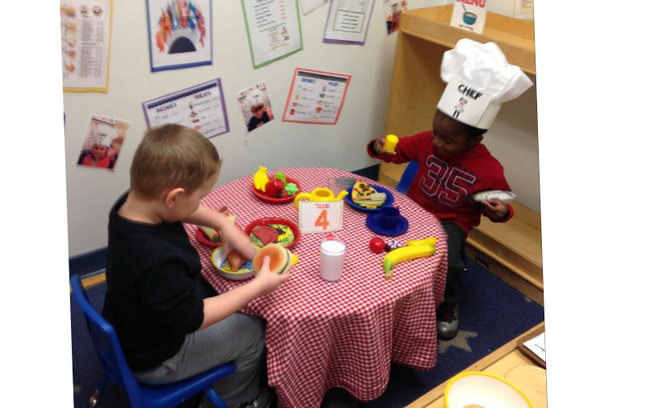

Prompt: What is happening in this visual text? Provide evidence from the text to support your claim.
TEACHER COLLECTS LANGUAGE SAMPLE SPF 1.0
STUDENT VISUAL TEXT
Notes:
Display the Student Visual Text
Direct students to use their Think Time
As the students play the game, the teacher listens and selects two students who will replay the game in front of the class to serve as models.
This is an opportunity to capture a language sample.

Slide 16


CONSTRUCTIVE CONVERSATION
FISHBOWL MODEL
PROMPT: What is happening in this visual text. Provide evidence from the text to support your claim.
Listen actively to what two partners say to each other.
FORMATIVE ASSESSMENT– TEACHER COLLECTS LANGUAGE SAMPLE SPF 1.0
Notes:
The two selected students will replay the game in front of the class and serve as models.
Student Progress Form (SPF)-­‐‑ Constructive Conversation Language Sample The teacher will collect a language sample from the two students on the Student Progress Form (SPF)-­‐‑ Constructive Conversation Language Sample to be used in Lesson 2. The language sample must be at least four turns in length. (Each turn includes both Partner A and B sharing

Slide 17
WRAP-UP
How did we meet today’s objective of using the Constructive Conversation Skill of FORTIFY?
How did you:
    Use your think time?
    Use the language of the skill
  Work with your conversation partner to do the following:
    Identify three things that you did to meet today’s objective
    Share and explain the three things to your partner
Notes:
Teacher will review ELD objective.
Today we engaged in a Constructive Conversation using the Constructive Conversation Skill-­‐‑FORTIFY. We took turns and shared ideas based on a visual text.
Teacher will ask students the following:
● How did we meet today’s objective of using the Constructive Conversation Skill of FORTIFY?
● How did you:
-Use your think time
-Use the language of the skill
● Work with your conversation partner to do the following:
Identify three things that you did to meet today’s objective
Share and explain the three things to your partner
Teacher calls on three students and they tell the class what was done today.

Slide 18
Start Smart 1.0
FORTIFY
Kindergarten
Lesson 9

Slide 19
ELD Objective
Students will be able to revise a Non-Model Conversation for the Constructive Conversation Skill- FORTIFY in a whole group setting and with a triad.
Notes:
Today we are going to review the Constructive Conversation Skill-­‐‑FORTIFY. When we create, we say what we notice about something.

Slide 20
Notes:
Let’s review the Conversation Norms Poster
Today, we will focus on:
Use the language of the skill
Use your conversation voice
**Give examples for both. Ask for student volunteers to model the two norms.

Slide 21
Conversation Norms
Notes:
Show Constructive Conversation Norms Video as a review of all norms

Slide 22
Hand Gesture and Phrase- FORTIFY
Supporting Our Ideas
Notes:
Model FORTIFY and have participants repeat with you:
Place hand, palm down in front of you as if putting an idea on the table. Use four fingertips of the other hand to support the palm.

Slide 23
Prompt and Response Starters
Prompt Starters:
How do you know…?
What is happening…?
Where did you get that information?
Show me in the text where…
Response Starters:
I know because…
I think ____, so____...
I have seen this in…
In the text…

Slide 25
Prompt:
What is happening in this visual text? Provide evidence from the text to support your claim.
TEACHER VISUAL TEXT
Notes:
Display the Student Visual Text
Direct students to use their Think Time

Slide 26
Listen to the Model Constructive Conversation
  Use your think time to study the visual text.
Listen actively to what two partners say to each other.
Notes:
Provide a copy of the Model Script to the volunteer and allow time beforehand for student to review the script. Suggestions for reading the script:
● Show a video of students having the model conversation (optional)
● Student volunteer and teacher read model script
STUDENT LISTEN ACTIVELY

Slide 27
What makes this a model conversation?
Partner A: I think what is happening is that the little kids are playing with blocks at school. What do you think is happening is the visual text?
Partner A: I notice that the students used lots of blocks to build something and they are sitting on it. What evidence can you use to support your claim?
Partner A: I notice a rug and bins like at school. I think they are at the blocks center. What can you add to your claim?
Partner A: I think what is happening is that they build a truck at the block center. What do you think?
Partner B: I think what is happening is the kids are pretending thy are construction workers. What evidence can you use to support your claim?
Partner B: I notice they are wearing boots, helmets and vests like construction workers. What evidence can you use to support your claim?
Partner B: I notice that all three boys are holding a block and pretending that they are driving. I agree with you that they are at the block center. What do you think?
Partner B: I think what is happening is that they are pretending to be construction workers and they made a truck using blocks at school.

Slide 28
Understanding the Skill of FORTIFY
Partner A: I think what is happening is that the little kids are playing with blocks at school. What do you think is happening is the visual text?
Partner A: I notice that the students used lots of blocks to build something and they are sitting on it. What evidence can you use to support your claim?
Partner A: I notice a rug and bins like at school. I think they are at the blocks center. What can you add to your claim?
Partner A: I think what is happening is that they build a truck at the block center. What do you think?
Partner B: I think what is happening is the kids are pretending thy are construction workers. What evidence can you use to support your claim?
Partner B: I notice they are wearing boots, helmets and vests like construction workers. What evidence can you use to support your claim?
Partner B: I notice that all three boys are holding a block and pretending that they are driving. I agree with you that they are at the block center. Now what do you think happening in the visual text?
Partner B: I think what is happening is that they are pretending to be construction workers and they made a truck using blocks at school.
Notes:
Understanding the Skill: Fortify
Teacher displays or distributes the Model Script from Lesson 8.
Student B:
I notice they are wearing boots, helmets and vests like construction workers. F What evidence can you use to support your claim? F
Student A:
I notice a rug and bins like at school. F I think they are at the blocks center. What can you add to your claim? F
Student B:
I notice that all three boys are holding a block and pretending that they are driving. F I agree with you that they are at the block center. Now what do you think is happening in the visual text? F
Student A:
I think what is happening is that they built a truck at the block center. F What do you think?
Let’s look at the Model Script to find evidence of the skills of CREATE, CLARIFY and FORTIFY. How are we using the visual text to guide our conversation?
Example of Think-Aloud:
Let’s look at the first set of turns. Read it to yourself as I read it aloud (see example above).
Let’s look at the language of the skill. Look at Student A’s response. How do I know Student A used the skill of FORTIFY? I notice the language of the skill (underline as noted above).
I know this is FORTIFY because it is asking for evidence from the text so I will label it with F (Write F next to the response.) I also notice that Student B is using the language of the skill to answer a FORTIFY question to provide evidence, so I will label it with F (Write F next to the response and underline as noted above). Student A responds with the language of the skill FORTIFY (underline as noted above). Also, they provide more evidence, based on what is in the visual text.
Teacher prompts student pairs to go through the same process with the rest of the Model Conversation. Students may share their responses in a whole group discussion led by the teacher

Slide 30
Listen to the Non-Model Constructive Conversation
  Use your think time to study the visual text.
Listen actively to what two partners say to each other.
Notes:
Provide a copy of the Non-Model Script to the volunteer and allow time beforehand for student to review the script. Suggestions for reading the script:
● Show a video of students having the model conversation (optional)
● Student volunteer and teacher read model script
STUDENT LISTEN ACTIVELY
STUDENTS SHOULD LISTEN ACTIVELY

Slide 31
Visual Text Non- Model
What is happening in this visual text. Provide evidence from the text to support your claim.
Partner A: I think they are playing. What do you think?
Partner A: I notice they have hats. What do you notice?
Partner A: I notice a rug. I think they are smiling. What do you think?
Partner A: They are playing at the block center. What do you think?
Partner B: I think they are sitting on blocks. What do you notice?
Partner B: I notice they are wearing boots. What do you notice?
Partner B: I notice they are driving. What is happening?
Partner B: They are construction workers.
Notes:
Teacher displays or distributes the Non-Model Script from Lesson 8.
Let’s look at the Non-Model Script. How can we improve this Constructive Conversation? This was our prompt, “What is happening in this visual text? Provide evidence from the text to support your claim.” Read it to yourself as I read it aloud. Think about the prompt and the language of the Constructive Conversation Skill FORTIFY.
Teacher will use questions and the Listening Task Poster to guide students through an analysis of what makes this a Non-Model Constructive Conversation for the skill of FORTIFY. See possible responses below.
No, they did not take turns sharing their ideas because partner A spoke two times in a row, without letting partner B take a turn
At first, they responded to the prompt, but towards the end they went off topic
They did not build on each other’s ideas
Teacher along with students revise the text on chart paper or document reader.
Non-Model:
Student A:
I think they are playing. What do you think? (not using language of the skill; not adding details to clarify ideas)
Student B:
I think they are sitting on blocks. What do you notice? (not using language of the skill)
Student A:
I notice they have hats. What do you notice? (not using language of the skill; not adding details to clarify ideas)
Student B:
I notice that they are wearing boots. What do you notice?
Student A:
I notice a rug. I think they are smiling. What do you think? (not adding details to clarify ideas)
Student B:
I notice they are driving. What is happening? (not adding details to clarify ideas)

Slide 32
REVISE
NON-MODEL
Note to Teacher: Consult pg. 38 of Start Smart 1.0 Lessons or Teacher Resources at end of
Power point
WHOLE-GROUP/CLASS REVISED NON-MODEL
Notes:
Teacher along with students revise the text on chart paper or document reader.
Revised* Non-Model:
*text indicates what the teacher should cross out as the text is being revised.
Bold indicates language revised.
Student A:
I think what is happening is that they three little boys made a pretend fire truck with blocks. What do you think is happening in the visual text?
Student B:
I think what is happening is that they are sitting on blocks at the blocks center and they are pretending to be firemen. What do you notice evidence can you use to support your claim?
Student A:
I notice that they have hats made three seats with the blocks. What do you notice evidence can you use to support your claim?
Student B:
I notice that they are wearing boots and one is wearing goggles. What do you notice evidence can you use to support your claim?
Student A:
I notice they are pretending to drive. They are all holding a block like they are driving. What do you think can you add to your claim?
Student B:
I notice they are driving. I agree with you that they are pretending to drive. Now Wwhat do you think is happening in the visual text?
Refer to class revised Non-Model, have pairs read.
Refer to the lesson for guidance

Slide 33
Prompt:
What is happening in this visual text? Provide evidence from the text to support your claim.
Notes:
Display the Student Visual Text
Direct students to use their Think Time

Slide 34

Language Sample Revision-Non-Model
You will work in a triad:
Number off from 1-3 to form a triad and select a student who will record the revision of the language sample
Read the language sample
Orally revise the language sample to improve the conversation
Use the prompt and response starters for FORTIFY
Be prepared to share out to the class
FORMATIVE ASSESSMENT– TEACHER COLLECTS LANGUAGE SAMPLE SPF 1.0
Notes:
Teacher will review ELD objective.
Today we revised a FORTIFY Non-­‐‑Model Constructive Conversation. We took turns and shared ideas based on a visual text.
Teacher asks students the following:
● How did we meet today’s objective of using the Constructive Conversation Skill of FORTIFY?
● How did you:
o use the language of the skill o use your conversation voice
● Work with your conversation partner to do the following:
o Identify three things that you did to meet today’s objective o Share and explain the three things to your partner
Teacher calls on three students and they tell the class what was done today.

Slide 35
WRAP-UP
How did we meet today’s objective of using the Constructive Conversation Skill of FORTIFY?
How did you:
    Use the language of the skill?
    Use your conversation voice?
Work with your conversation partner to do the following:
    Identify three things that you did to meet today’s objective
    Share and explain the three things to your partner

Slide 36
Start Smart 1.0
FORTIFY
Kindergarten
Lesson 10

Slide 37
ELD Objective
ELD Objective: Students will be able to engage in a Constructive Conversation using the Constructive Conversation Skill of FORTIFY, by sharing ideas and taking turns based on a visual text with a partner.
Notes:
Today we are going to practice the Constructive Conversation Skill FORTIFY. When we observe or read something new we have many thoughts and ideas. As we engage in a FORTIFY conversation, our job as speakers is to create and take ownership of our ideas. As listeners our role is to value and foster them same or different ideas we hear.

Slide 38
Notes:
Let’s chorally read the Conversation Norms Poster.
Use your think time
Use the language of the skill
Use your conversation voice
Listen respectfully
Take turns and build on each other’s ideas
Today, we will focus on:
Listen respectfully
Take turns and build on each other’s ideas

Slide 39
Conversation Norms
Notes:
Show Constructive Conversation Norms Video as a review of all norms

Slide 41
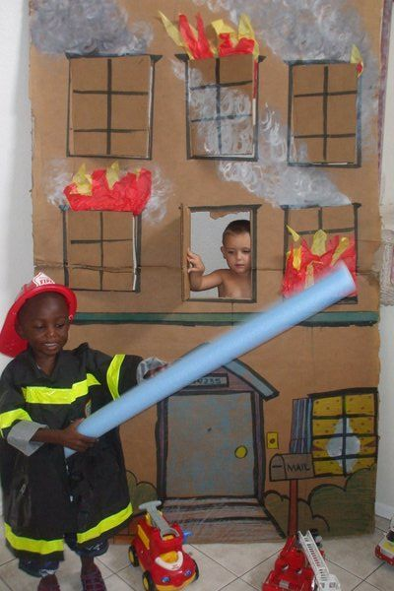
Prompt:
What is happening in this visual text? Provide evidence from the text to support your claim.
TEACHER VISUAL TEXT
Notes:
Display the Student Visual Text
Direct students to use their Think Time

Slide 42
Listen to the Model Constructive Conversation
  Use your think time to study the visual text.
Listen actively to what two partners say to each other.
Notes:
Provide a copy of the Model Script to the volunteer and allow time beforehand for student to review the script. Suggestions for reading the script:
● Show a video of students having the model conversation (optional)
● Model with a student using the Model Script.

Slide 43
Visual Text Model
What is happening in this visual text. Provide evidence from the text to support your claim.
Partner A: I think what is happening is that they are playing firemen. What do you think is happening in the visual text?
Partner A: I think they are playing firemen because one boy is dressed like a fireman and there are toy fire trucks next to him. What evidence can you use to support your claim?
Partner A: I think they are playing firemen because the boy in the burning house is looking for the fireman. What evidence can you use to support your claim?
Partner A: I think they are playing and pretending that the house is on fire and the little boy is not wearing a shirt because he was sleeping. What do you think is happening in the visual text?
Partner B: I think what is happening is they are pretending and the firemen is going to rescue the boy. What evidence can you use to support your claim?
Partner B: I think he is going to rescue the boy because he has a water hose to use to stop the fire. What evidence can you use to support your claim?
Partner B: I think they are pretending and the firemen is going to use the fire trucks and ladders to turn off the fire. Now what do you think is happening in the visual text?
Partner B: I think they are pretending the house is on fire and the fireman is going to use the hose and ladder to rescue the boy.

Slide 45
Listen to the Non-Model Constructive Conversation
  Use your think time to study the visual text.
Listen actively to what two partners say to each other.
WHAT DO YOU NOTICE IN THE VISUAL TEXT? CITE DETAILS TO CLARIFY YOUR IDEAS.
Notes:
Provide a copy of the Non-Model Script to the volunteer and allow time beforehand for student to review the script. Suggestions for reading the script:
● Show a video of students having the model conversation (optional)
● Model with a student using the Non-Model Script.

Slide 46
Visual Text Non- Model
What is happening in this visual text. Provide evidence from the text to support your claim.
Partner A: They are playing and the house is on fire. What do you think?
Partner A: They drew the house. It is not real.
Partner A: Why doesn’t the boy have a shirt?
Partner A: They have toy trucks.
Partner B: The little boy inside the house is trying to get out. The fire is not real. What do you think?
Partner B: The hose is a tube for swimming.
Partner B: The boy is wearing a fireman costume.
Partner B: The trucks are red.

Slide 47
Constructive Conversation Game
PROMPT:
What is happening in this visual text? Provide evidence from the text to support your claim.
Rules of the game:
Each of you needs one CREATE, two CLARIFY and two FORTIFY cards
Each of you will play one card as you share your CREATE, CLARIFY and FORTIFY ideas. You will continue taking turns until all cards are placed in the middle.
If you’re done early repeat the process for an additional round.
Remember to use the Constructive Conversation Norms and Skills as you play the game.
Notes:
You are now going to have the opportunity to practice the Constructive Conversation Skill FORTIFY while playing a game.
Explain the rules of the Constructive Conversation Game to students.

Slide 48
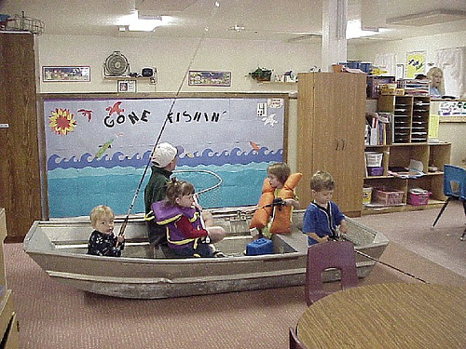
Prompt: What is happening in this visual text? Provide evidence from the text to support your claim.
TEACHER COLLECTS LANGUAGE SAMPLE SPF 1.0
STUDENT VISUAL TEXT
Notes:
Display the Student Visual Text
Direct students to use their Think Time
As the students play the game, the teacher listens and selects two students who will replay the game in front of the class to serve as models.
This is an opportunity to capture a language sample.

Slide 49
CONSTRUCTIVE CONVERSATION
FISHBOWL MODEL
PROMPT: What is happening in this visual text. Provide evidence from the text to support your claim.
Listen actively to what two partners say to each other.
FORMATIVE ASSESSMENT– TEACHER COLLECTS LANGUAGE SAMPLE SPF 1.0
Notes:
The two selected students will replay the game in front of the class and serve as models.
Student Progress Form (SPF)-­‐‑ Constructive Conversation Language Sample The teacher will collect a language sample from the two students on the Student Progress Form (SPF)-­‐‑ Constructive Conversation Language Sample to be used in Lesson 2. The language sample must be at least four turns in length. (Each turn includes both Partner A and B sharing

Slide 50
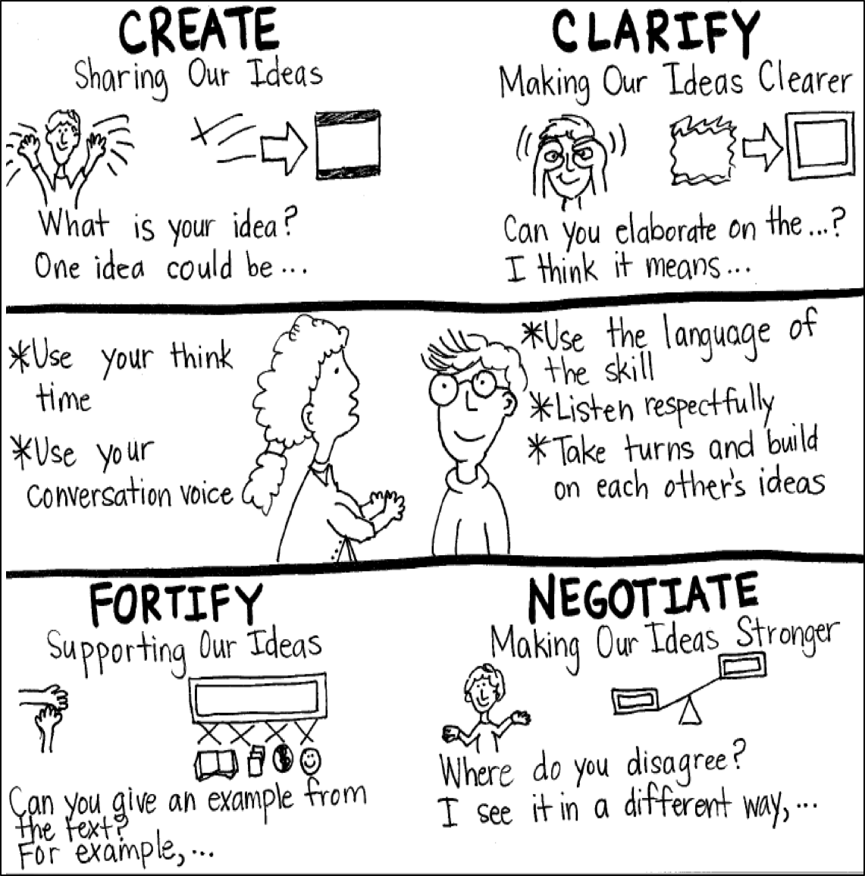
Model Creating Class Constructive Conversation Poster
Sample
Notes:
Teacher models creating a Constructive Conversation Poster. This slide is a resource. Teacher elicits student responses to help student develop a poster that illustrates their understanding of the FORTIFY skill and conversation norms.

Slide 51
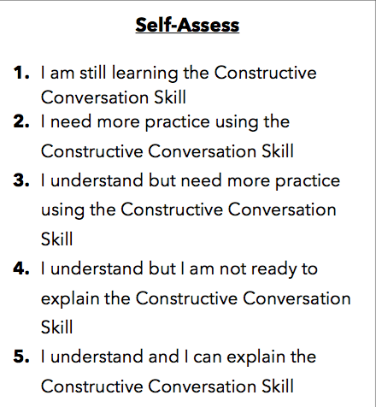
Notes:
Teacher will review the Constructive Conversation Skill FORTIFY
Students will self-assess answering the prompt
Teacher may select a conversation pair to share out.
EXAMPLE:
Student: I rated myself a 3 because…
Teacher: What can you do to move to a 4?

Slide 52
Teacher Resources

Slide 53
FORTIFY Non-Model Revision

